Slide 1

Approximate Query Processing in SQL-on-Hadoop
Mai Hai Thanh
KIWI
2014.08.19

Slide 2
Motivation
Need for very fast analytical query processing
Experts believe that faster is better
Time is valuable (so, Map/Reduce is not enough)
Waiting for interactive queries to complete (seconds to minutes) is OK, but why not less time ?!
Waiting for batch queries (hours) to complete is a real pain
SQL-on-Hadoop market, dominance of solutions that focus on interactive analytics

Slide 3
Motivation
Current approaches (Tez DAG, Spark in-memory processing) have technical limitations
→ need a new/additional approach

Slide 4
Approximate query processing
A popular approach to improve query performance
Widely acceptable in real-life
DSS applications usually exploratory: early feedback to help identify “interesting” regions
Iteratively explorative analytics is a main theme of big data app
Preview answers while waiting. Trial queries
Precision to “last decimal” is often not needed
Some kinds of data are even not exact at the beginning
Internet of Things’ machine generated data (e.g., sensors data)
Notes:
DSS: Decision Support System

Slide 5
Approximate query processing
Example: personal data for medical treatment
Sum of walking distance done in the last week
Exact result: 5682.2 meters
Approximate result: 5.68 km → acceptable ?!
Sum of time using PC, tablet, and smart phone in a day
Exact result: 30601.7 seconds
Approximate result: 8.5 hours → acceptable ?!

Slide 6
Approximate query processing
Example: website traffic analysis
Count number of users of a website during last weekend
Exact answer: 16,835
Approximate answer: 16,800 -> acceptable ?!
Example: real-time booking
Compare hotels A and B based on room prices
Exact data: A: $60.3/night; B: $70.6/night
Approximately data: A < $63/night; B: > $68/night
-> Can get exact answer with approximate data: A is cheaper than B

Slide 7
Approximate query processing
(AQP)
AQP and SQL-on-Hadoop
Theoretically independent
Can co-exist with DAG and in-memory processing
Can be applied to any solution (Spark, Hive, Tajo,…)
Users can easily switch between “approximate” and “exact” options

Slide 8
Related work
Presto
Approximate distinct counts
Approximate percentiles

Slide 9
Related work
BlinkDB
A large-scale data warehouse built on Shark and Spark
Answer HiveQL queries up to 200-300 times faster than Hive by executing them on samples of data and providing approximate answers with error bars
Currently support COUNT, AVG, SUM and PERCENTILE
Being extended to support User-Defined Functions (UDFs)

Slide 10
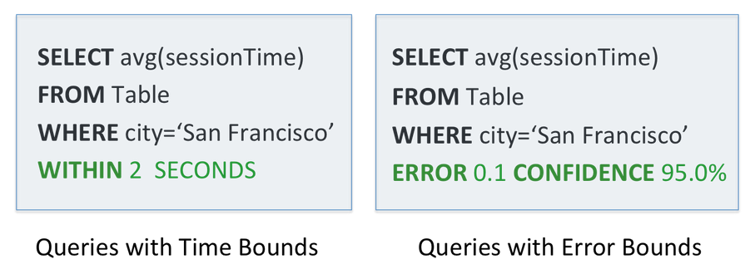
Related work
BlinkDB

Slide 11
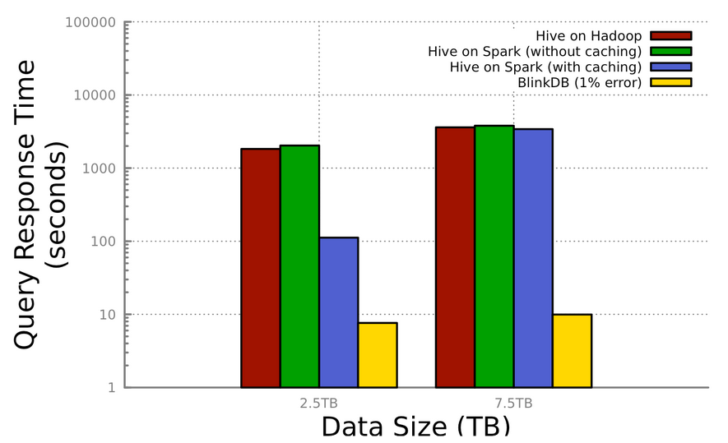
Related work
BlinkDB
Log scale

Slide 12
Problem definition
(@KIWI) Provide approximate query processing ability for SQL-on-Hadoop data warehouses
With/without accuracy/time guarantee
Example
SELECT AVG(age) FROM Persons WHERE Department=‘Cloud Computing’ EXPECTED ACCURACY 98% | SELECT item_id, sale_count FROM Sale_Items EXPECTED ACCURACY 97%

Slide 13
Problem definition
Potential query types
Aggregation (avg, sum, count, median, quantile,…)
Sort (ORDER BY)
LIMIT (or, TOP)
K nearest neighbors
Every normal SELECT query with a big result set
…

Slide 14
Approach
Samples (@BlinkDB)
Pre-create data samples
At query time, use samples to answer queries
Histograms
Pre-construct histograms
At query time, implicitly map the histogram back to an approximate relation & apply the query to the approximate relation
Wavelets

Slide 15
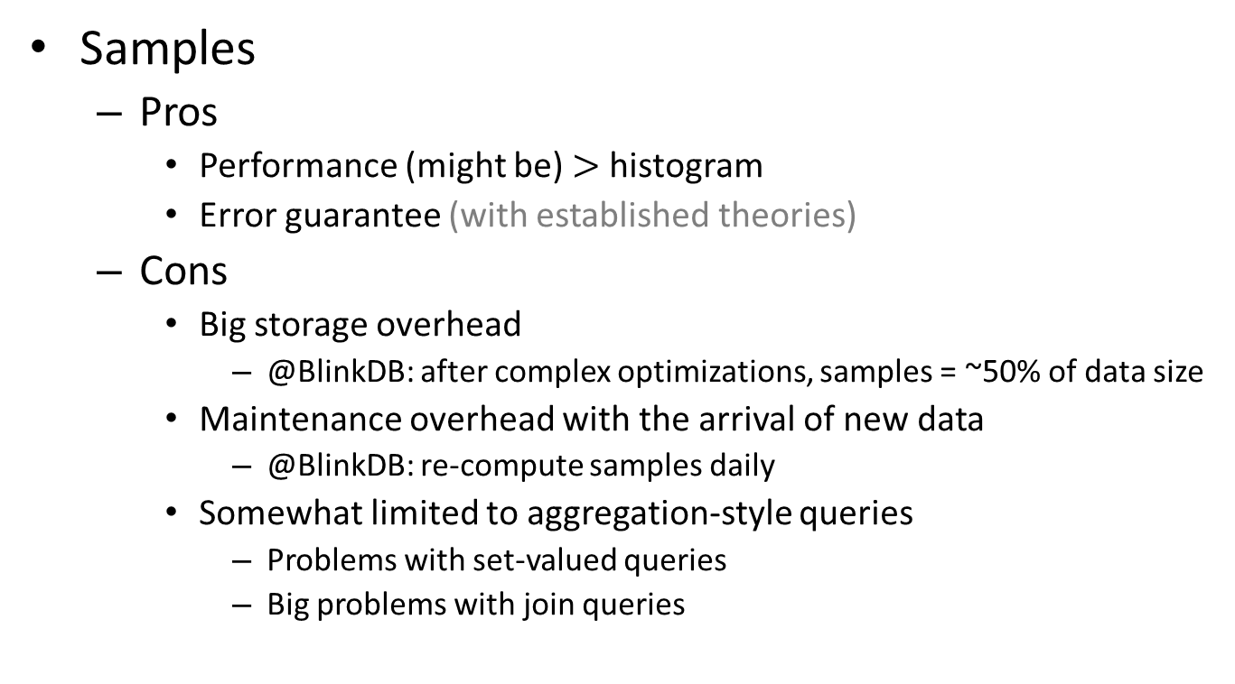
Approach
Samples
Pros
Performance (might be) $>$ histogram
Error guarantee (with established theories)
Cons
Big storage overhead
@BlinkDB: after complex optimizations, samples = ~50% of data size
Maintenance overhead with the arrival of new data
@BlinkDB: re-compute samples daily
Somewhat limited to aggregation-style queries
Problems with set-valued queries
Big problems with join queries

Slide 16
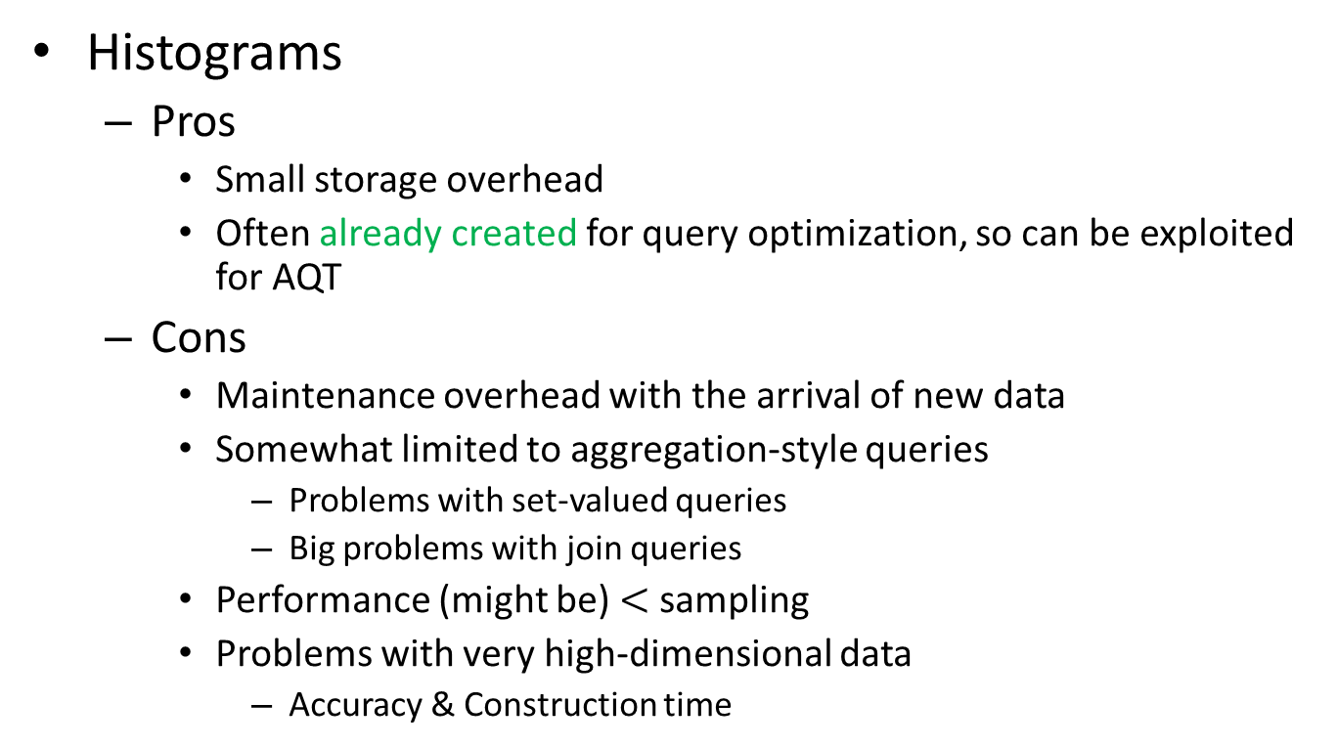
Approach
Histograms
Pros
Small storage overhead
Often already created for query optimization, so can be exploited for AQT
Cons
Maintenance overhead with the arrival of new data
Somewhat limited to aggregation-style queries
Problems with set-valued queries
Big problems with join queries
Performance (might be) $<$ sampling
Problems with very high-dimensional data
Accuracy & Construction time
Similar to
Samples

Slide 17
Approach
Wavelets
Limited to numerical data

Slide 18
Approach – Potential
Physical plan generation
Early data partition pruning
Data scanning
On-the-way data pruning/skipping
Task scheduling
Stop remaining tasks early if required accuracy has been obtained

Slide 19
Approach – Potential
Data statistics help to decide which parts of the data to prune/skip
Monitor access patterns
Tables / columns / data ranges that are accessed more frequently have more detailed histograms / samples
Each time data is transferred to answer a query, statistics might be updated

Slide 20
Conclusion
AQP is difficult, but useful

Slide 21
References
The three most common ways data junkies are using Hadoop. http://gigaom.com/2013/12/15/the-three-most-common-ways-data-junkies-are-using-hadoop/
Approximate Query Processing: Taming the Terabytes. http://www.pittsburgh.intel-research.net/people/gibbons/talks-surveys/VLDB01-tutorial-Garofalakis-Gibbons.ppt
Presto: Interacting with petabytes of data at Facebook. https://www.facebook.com/notes/facebook-engineering/presto-interacting-with-petabytes-of-data-at-facebook/10151786197628920
BlinkDB. http://blinkdb.org/
BlinkDB wiki. https://github.com/sameeragarwal/blinkdb/wiki

